Slide 1



A CENTER FOR INTER-DISCIPLINARY RESEARCH
2020-21
TITLE
“PROJECT TITLE”
PREDICTION OF DISEASES
SUPERVISED BY
MENTOR NAME JATIN MENGHWANI
GOKARAJU RANGARAJU
INSTITUTE OF ENGINEERING AND TECHNOLOGY
AUTONOMOUS

Slide 2
Advanced Academic Center
( A Center For Inter-Disciplinary Research )
This is to certify that the project titled
“PREDICTION OF DISEASES”
is a bonafide work carried out by the following students in partial fulfilment of the requirements for Advanced Academic Center intern, submitted to the chair, AAC during the academic year 2020-21.
NAME | ROLL N0 | BRANCH
THADURI AJITH | 21241A1258 | IT
MANGALI PURNA CHANDRA | 21241A66G6 | AIML
GANESH DANDAVENI | 21241A0480 | ECE
RAJAPU DEEPIKA | 21241A04A8 | ECE
SWETHA SOUNDARARAJAN | 21241A6755 | CSDS

Slide 3
This work was not submitted or published earlier for any study
Dr/Ms./Mr.
Dr.B.R.K.Reddy
Program Coordinator
Dr.Ramamurthy Suri
Associate Dean,AAC
Project Supervisor

Slide 4
ACKNOWLEDGEMENTS
We express our deep sense of gratitude to our respected Director, Gokaraju Rangaraju Institute of Engineering and Technology, for the valuable guidance and for permitting us to carry out this project.
With immense pleasure, we extend our appreciation to our respected Principal, for permitting us to carry out this project.
We are thankful to the Associate Dean, Advanced Academic Centre, for providing us an appropriate environment required for the project completion.
We are grateful to our project supervisor who spared valuable time to influence us with their novel insights.
We are indebted to all the above mentioned people without whom we would not have concluded the project.

Slide 5
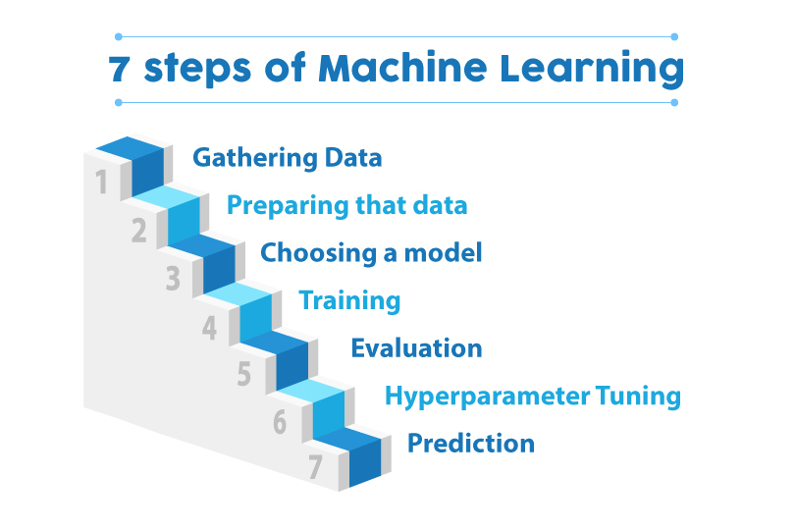
ABSTRACT
The project is aimed to predict the disease and its precautions based on the physical symptoms. The project proceeds with the intake of the dataset. The dataset is used to predict the disease of the person. Overall, this project solves the problem for people unaware of medical conditions and diseases during their rough times. It provides appropriate diseases which can be helpful to get an opinion of their condition. These days people are neglecting to visit the hospital until the problem gets severe so this project may help people of economical classes to get a first opinion. The study aims to assess whether it is possible to predict a person's disease using machine learning
INTRODUCTION:

Slide 6
Machine learning is a branch of artificial intelligence (AI) and computer science that focuses on using data and algorithms to imitate how humans learn, gradually improving its accuracy. Machine learning algorithms use historical data as input to predict new output values Machine learning is used in internet search engines, email filters to sort out spam, websites to make personalized recommendations, banking software to detect unusual transactions, and lots of apps on our phones such as voice recognition.
Here we are with our project based on machine learning -
On the prediction of Diseases using machine learning techniques. Accurate disease prediction needs expert knowledge it can not be understandable by common people. Because there are an infinite number of diseases, they have different symptoms, and combinations of different symptoms lead to different diseases. So, it is a very complex task to decide on the Disease. Even Experts use this type of machine learning software to confirm their predictions. In this paper, we applied different methods and techniques to achieve higher precision of the used car price prediction. The Decision Tree algorithm uses a data structure called a tree to predict the outcome of a particular problem. Since the decision tree follows a supervised approach, the algorithm is fed with a collection of pre-processed data. This data is used to train the algorithm.
Decision Trees are versatile and powerful machine learning algorithms that can perform both classification and regression tasks and even multioutput tasks. Decision Trees are also the fundamental components of Random Forest, which are among the most powerful Machine Learning algorithms available today.

Slide 7
PROJECT WORK FLOW:
Collected the data from different sources.
We have done changes to the raw data.
Imported the required libraries and modules.
Imported the dataset as the data frame.
Dropped the unnecessary columns and NULL/NAN values in the dataset.
Splitting the dataset into train and test data frame.
We finalized the dependent and the independent values.
Using Decision Tree Regression on the data we got the values.
We have got the accuracy of 99.996%.
To improve the accuracy we can even use different models like Random Forest Classifier, KNN, etc.

Slide 8
INPUTS
Symptoms
OUTPUT
Disease
Precautions
Description

Slide 9
DECISION TREE REGRESSION A decision tree builds regression or classification models in the form of a tree structure. It breaks down a dataset into smaller and smaller subsets while at the same time an associated decision tree is incrementally developed. The final result is a tree with decision nodes and leaf nodes. A decision node (e.g., Outlook) has two or more branches (e.g., Sunny, Overcast, and Rainy), each representing values for the attribute tested. Leaf node (e.g., Hours Played) represents a decision on the numerical target. The topmost decision node in a tree that corresponds to the best predictor is called the root node. Decision trees can handle both categorical and numerical data. The core algorithm for building decision trees called ID3 by J. R . Quinlan which employs a top-down, greedy search through the space of possible branches with no backtracking. The ID3 algorithm can be used to construct a decision tree for regression by replacing Information Gain with Standard Deviation Reduction
A decision tree is built top-down from a root node and involves partitioning the data into subsets that contain instances with similar values (homogenous). We use standard deviation to calculate the homogeneity of a numerical sample. If the numerical sample is completely homogeneous its standard deviation is zero.

Slide 10
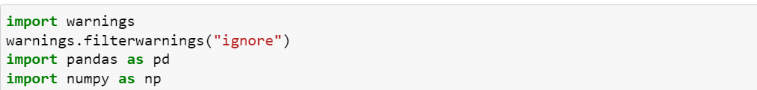
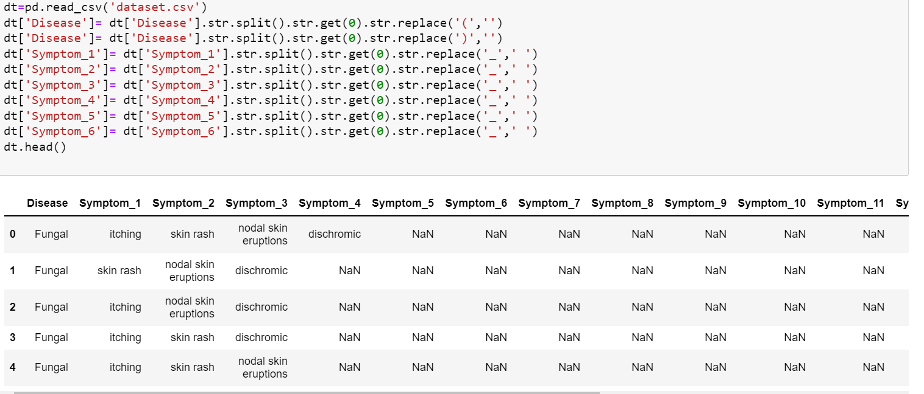
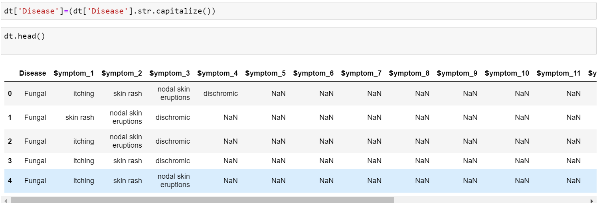
CODE OF THE PROJECT:
1.Importing the libraries and import warnings to ignore.
2.Reading the dataset and cleaning it.
3.Capitalizing the diseases.

Slide 11
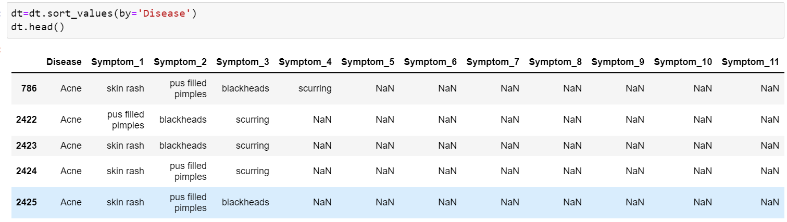
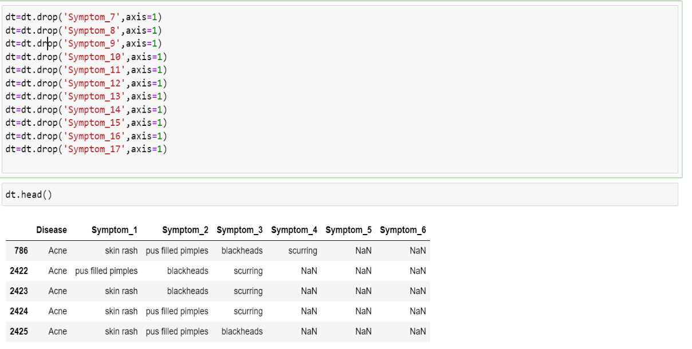
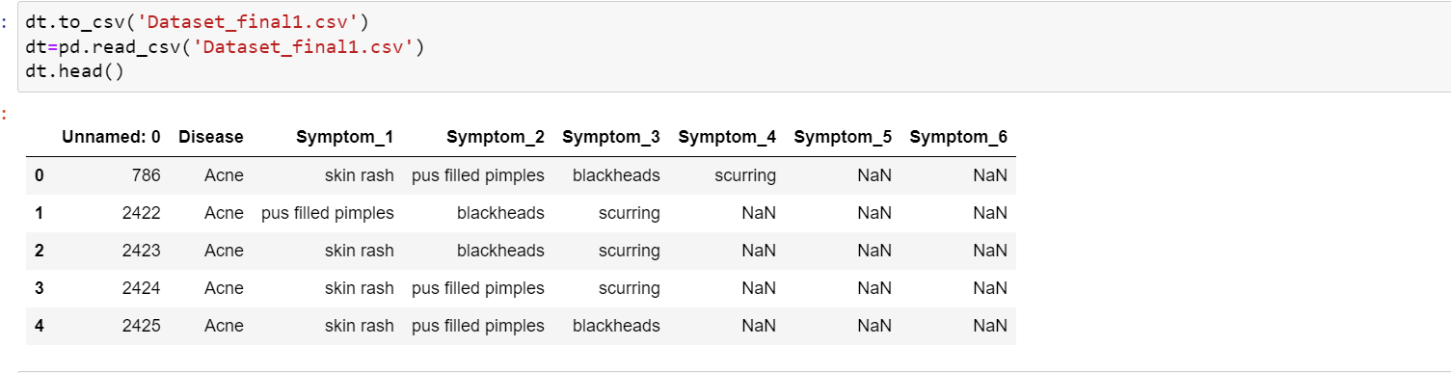
4.Arranging the diseases in the alphabetical order.
5.Dropping the symptoms from 7 to 17 through the columns.
6.Storing the dataset in dataset final.

Slide 12
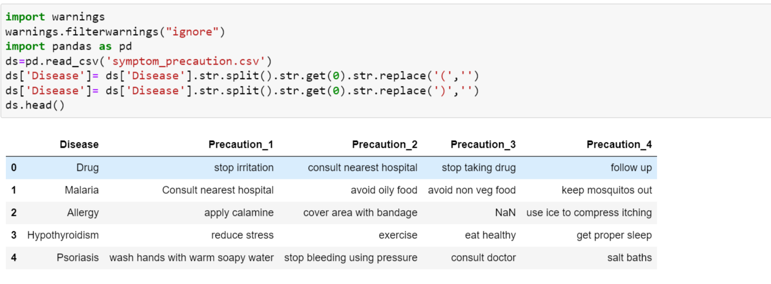
7.Removing unnamed from the dataset.
8.Final dataset of the disease is stored.
9.Importing the libraries and warnings.

Slide 13
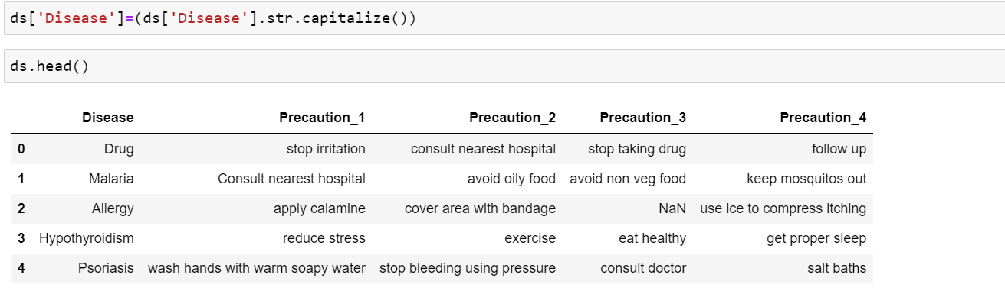
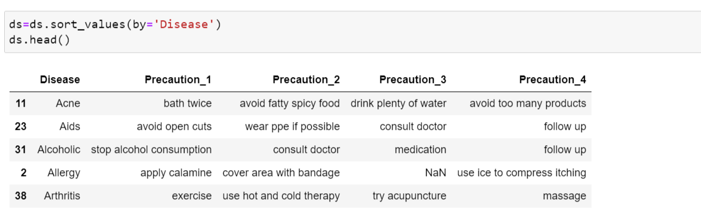
10.Capitalizing the precautions.
11.Arranging the precautions in the alphabetical order.

Slide 14
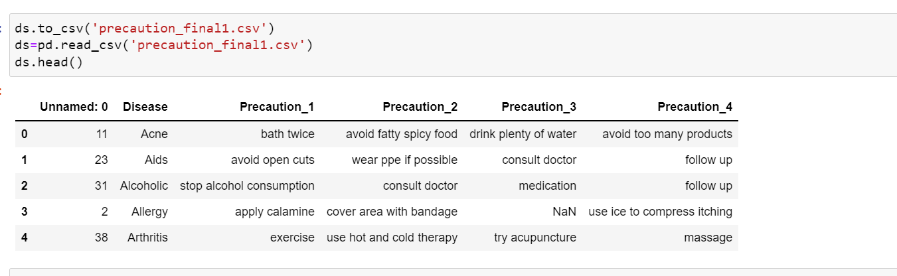
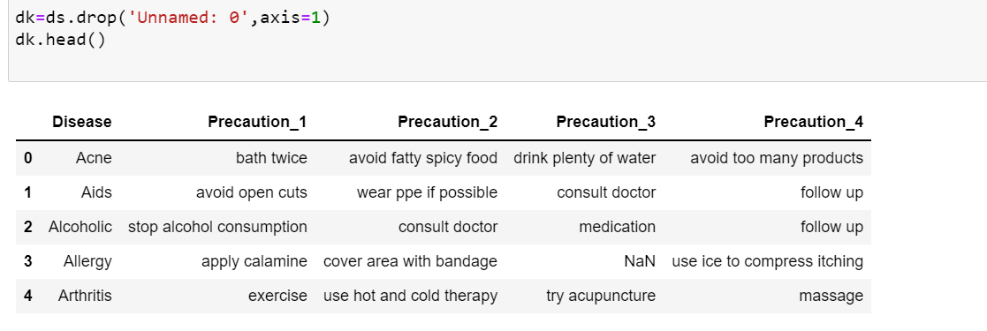
12.Storing the precautions to final dataset.
13.Removing the unnamed from the precautions dataset.
14.Stored final dataset.

Slide 15
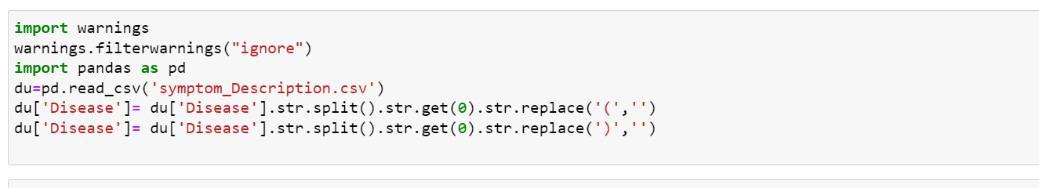
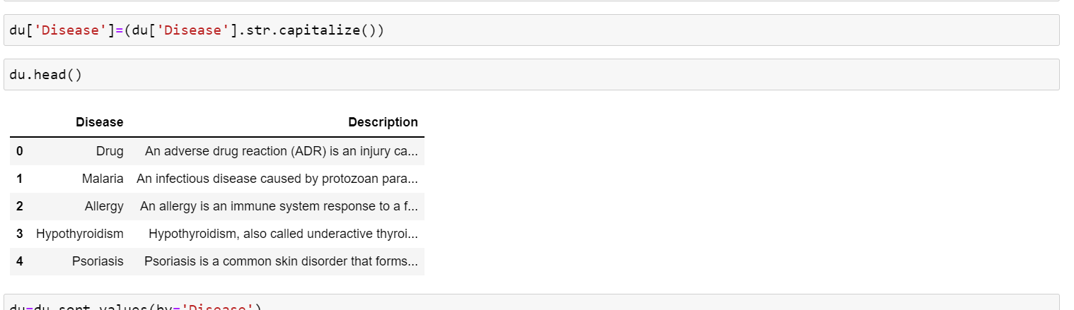
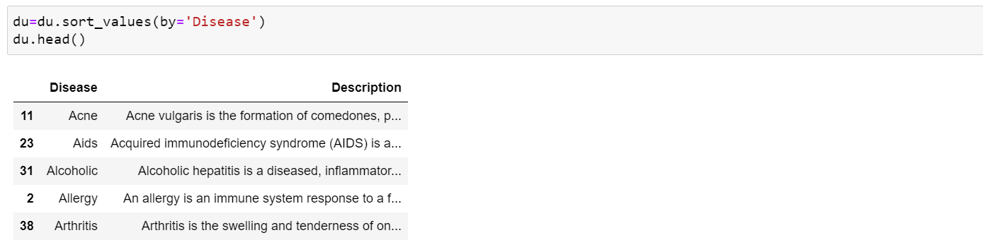
15.Importing the libraries and warnings.
16.Capitalize the description.
17.Arranging the description in alphabetical order.

Slide 16
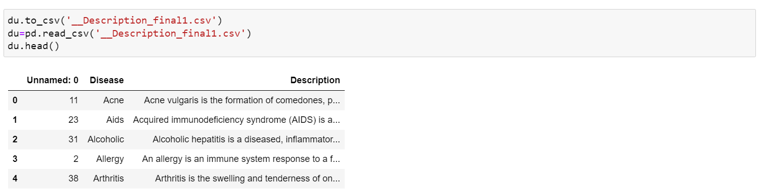
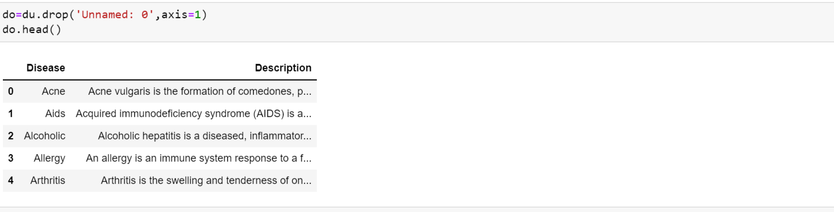
18.Storing final description dataset.
19.Removing the Unnamed axis.
20.Stored final dataset of description.

Slide 17
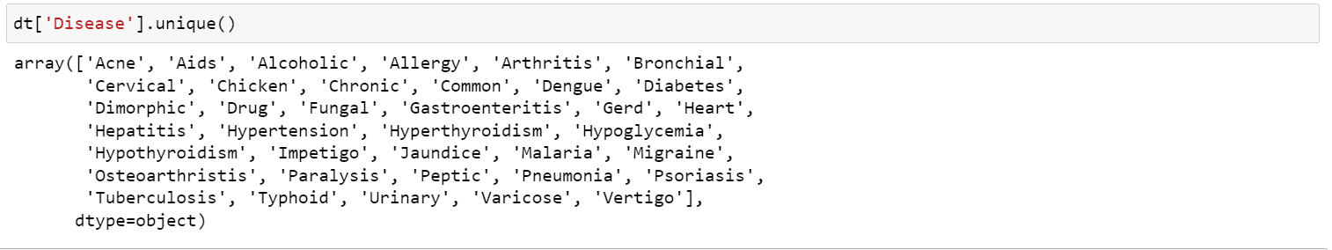
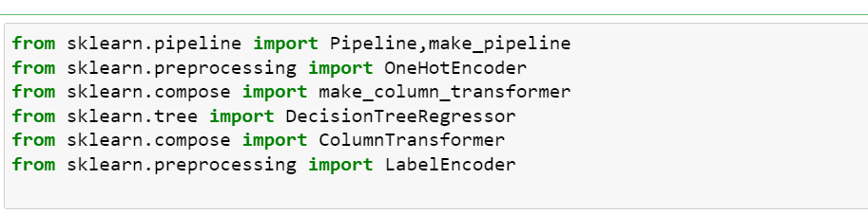
21.Printing all diseases which are unique as array.
22.Showing all the diseases one by one placing in the code.
23.Importing the libraries from the decision tree regression.
24.Removing unnamed axis.
25.Replacing ‘NaN’ by ‘no’ in the symptoms.

Slide 18
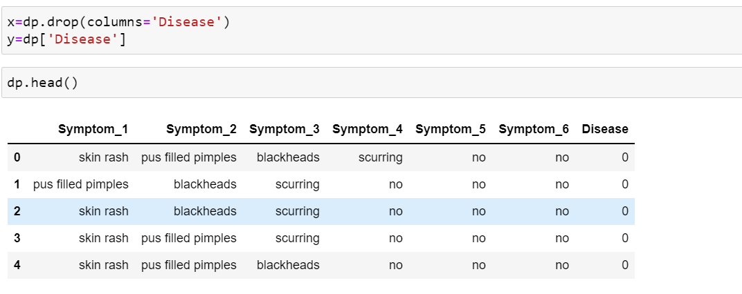
26.Importing the LabelEncoder to transform the diseases.
27.Dropping the diseases through the axis.
28.Put Disease as lab.
29.After dropping the diseases the dataset.Separting the diseases and symptoms. Here diseases are independent and symptoms are dependent.

Slide 19
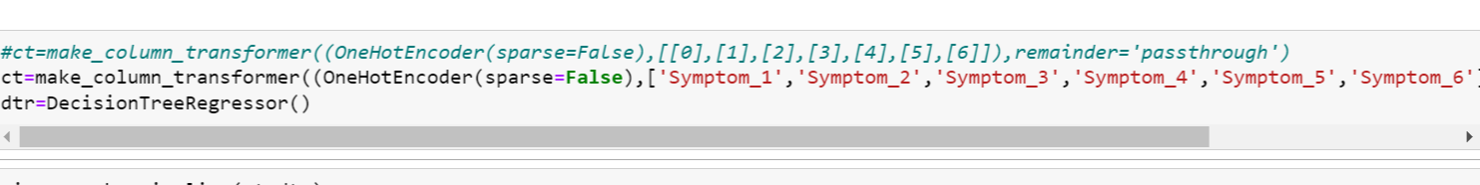
30.Testing and training the dataset by importing the sklearn model selection and train test split.
31.We use onehotencoder to fit the disease datatype into ohe.
32. Making the pipeline through the column transformer from decision tree regressor.

Slide 20
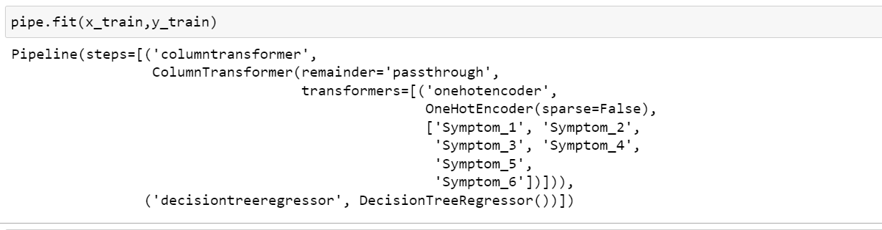
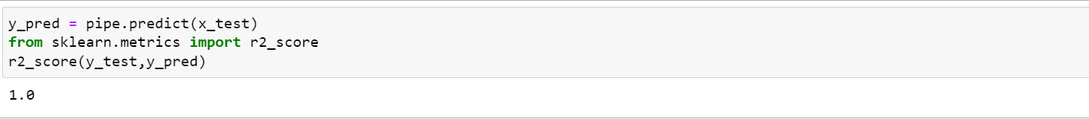
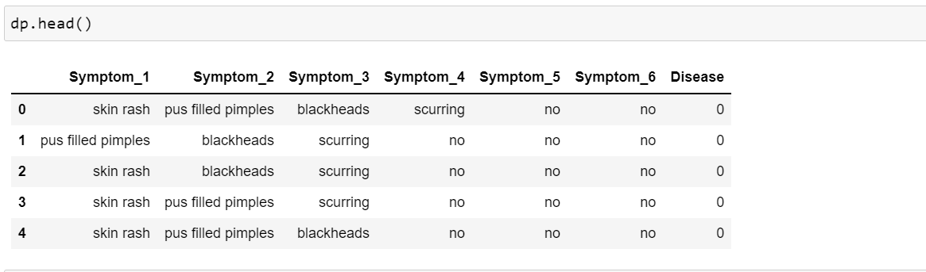
33.Fitting the pipeline through it.
34.Now we start the prediction. Here we then find the accuracy of our prediction using r2_score.
As we can see we got that accuracy of 1.0 nearly 100% which is good for prediction.

Slide 21
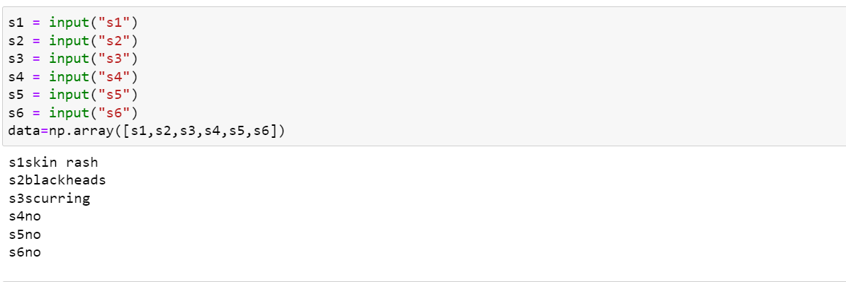
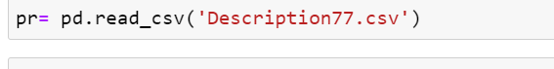
35.We will input the symptoms from 1 to 6 here.
Here some of the examples of symptoms are inputted.
36.We now start the prediction.
37.Importing final dataset of description.

Slide 22
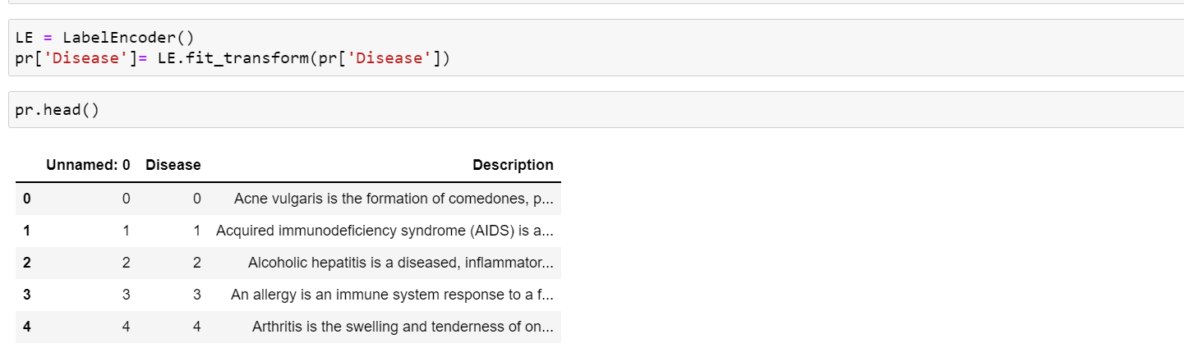
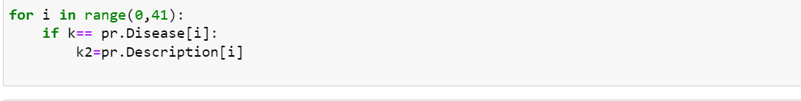
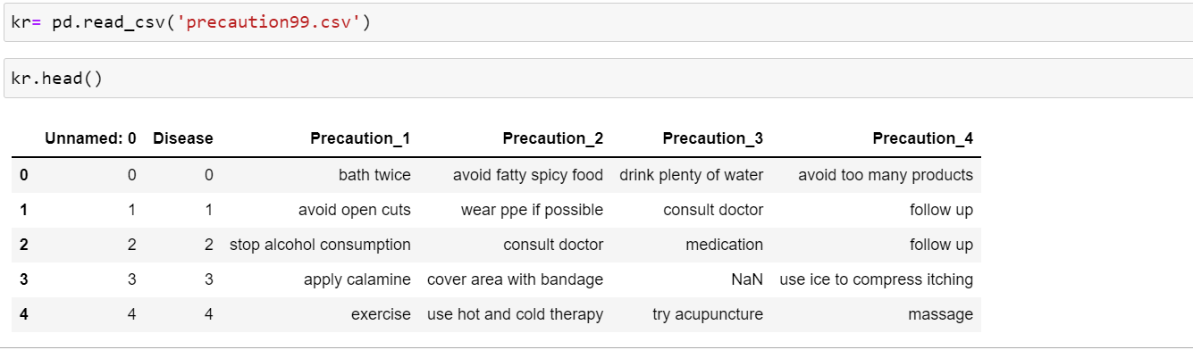
38.LabelEncoder transform to numerical labels of the description.
39.Inputting the description.
40.Importing final dataset of the precautions.

Slide 23
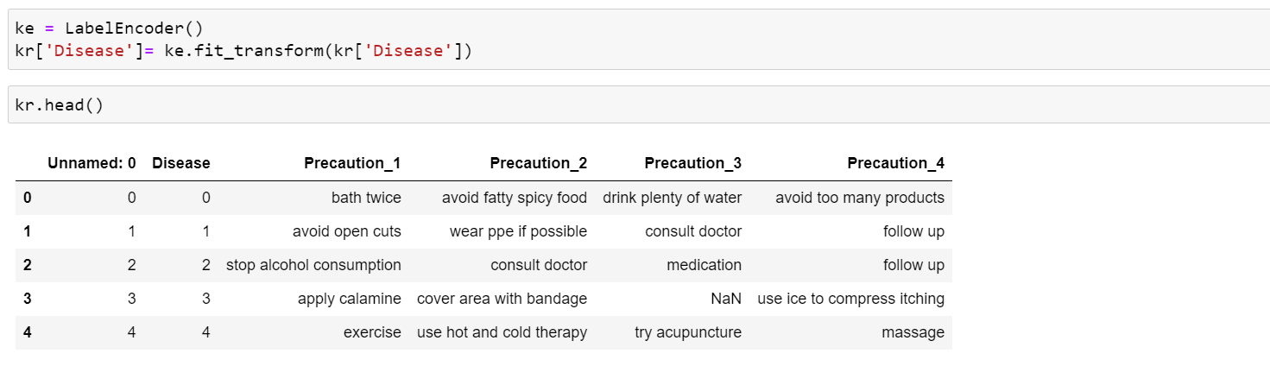
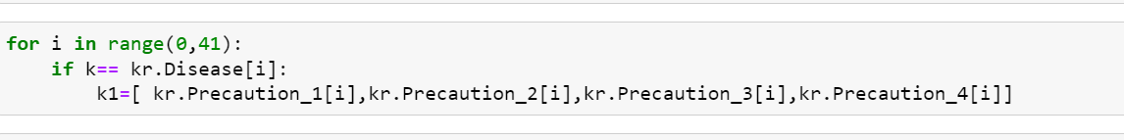
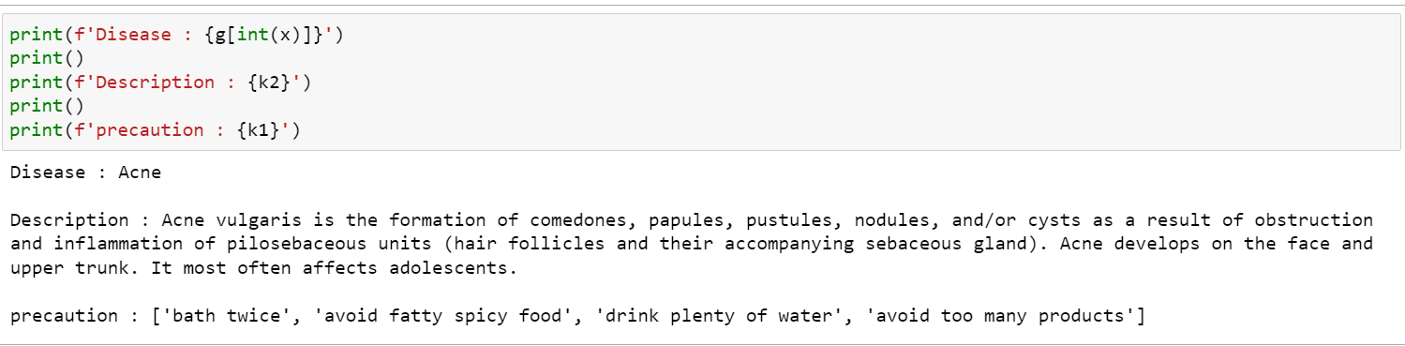
41.LabelEncoder used to transform to numerical labels of the precautions.
42. Inputting the precautions.
43.By inputting the symptoms the disease was predicted accordingly the description of the disease was predicted at the same time the precautions of the disease was predicted.

Slide 24
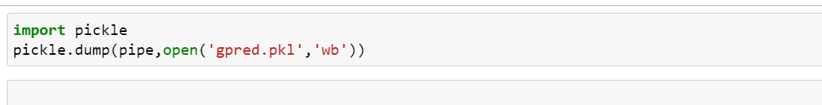
44.We import pickle and dump the data.

Slide 25
FUTURE DEVELOPMENTS:
We can add new diseases day by day into the real-time code.
We can further develop an interface to attract people around the globe.
We can add the severity of the disease to the real-time code.
We can add the rate of spread of the diseases to the real-time code.
We can add basic medicine suggestions to the disease.
We can suggest which type of doctor to contact.

Slide 26
REFERENCES:
https://en.wikipedia.org/ - WIKIPEDIA https://towardsdatascience.com/ - TDS www.mygreatlearning.com - MYGL www.educba.com - EDUCBA

